Slide 1

ENGINEERING CHEMISTRY
Asha A
Department of Science and Humanities

Slide 2

ENGINEERING CHEMISTRY
Module 5- Energy storage devices – Fuel cells
Class content:
H₂ – O₂ alkaline fuel cell
Principle
Construction and working
Advantages
Disadvantages

Slide 3
ENGINEERING CHEMISTRY
Module 5- Energy Storage devices- Fuel cells
Alkaline fuel cells
Aqueous solution of KOH is used as electrolyte
Low temperature fuel cell (operates at 100ºC)
Oxygen reduction is more rapid in alkaline electrolytes
than in acid electrolytes
Use of non noble metal electro-catalyst is feasible
Carbon containing fuels cannot be used as CO₂ is
formed as product which reacts with the electrolyte, KOH, to form K₂CO₃ which reduces efficiency of the cell
CO₂ + KOH → K₂CO₃ + H₂O

Slide 4
ENGINEERING CHEMISTRY
Module 5- Energy Storage devices- Fuel cells
Construction :
Anode : Porous carbon impregnated with Pt catalyst
Cathode : Porous carbon impregnated with Ag catalyst
Fuel : Hydrogen gas
Oxidant : Oxygen gas
Electrolyte : 30-45 % KOH(warm)

Slide 5
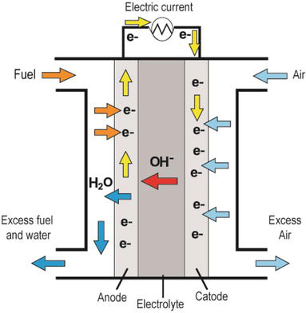
ENGINEERING CHEMISTRY
Module 5- Energy Storage devices- Fuel cells
Cell representation:
H₂ Pt KOH Ag O₂
Source:https://www.intechopen.com/books/new-trends-in-ion-exchange-studies/hydroxide-transport-in-anion-exchange-membranes-for-alkaline-fuel-cells

Slide 6
ENGINEERING CHEMISTRY
Module 5- Energy Storage devices- Fuel cells
Working:
H₂ gas diffuses through anode ,gets adsorbed on the electrode surface ,reacts with OH- to form water
At cathode O₂ diffuses through electrode, is adsorbed and reduced to OH-
Product is water which dilutes the KOH
Cell operates at 100ºC, so that water from KOH escapes as steam
The water was used by astronauts for drinking on Apollo spacecraft
Emf = 1.23 V

Slide 7
ENGINEERING CHEMISTRY
Module 5- Energy Storage devices- Fuel cells
Advantages:
Operates at low temperature
Alkali is used as electrolyte hence non noble metal catalyst can
be used so less expensive
Disadvantages:
Reactants must be free from C, because on oxidation CO₂ is formed .The alkali reacts with CO₂ to form carbonates which reduce efficiency of the cells; pure fuel and oxidant which are free of carbon compounds must be used
Liquid electrolytes pose handling problems

Slide 8
THANK YOU
Asha A
Department of Science and Humanities

